Slide 1
Manufacturing, Technology & Collaboration
Asian Solar Energy Initiative
Bangkok 2011
Dr. Jorge Servert
Solar Technology Advisors S.L.
Plaza de Manolete, 2, 11-C
28020 Madrid, Spain
Tel. +34 91 383 58 20
Fax. +34 91 767 01 29

Slide 2
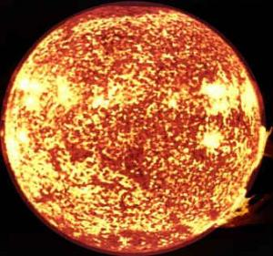
ENERGY
Clean
Cheap
Reliable
Stable
Safe

Slide 3
Innovation
Private public partnership, how risk and profits are shared?
Cooperation between R&D and Companies
Long term focus
Countries’ competitive advantage
O & M and performance
Different products for different needs and markets

Slide 4
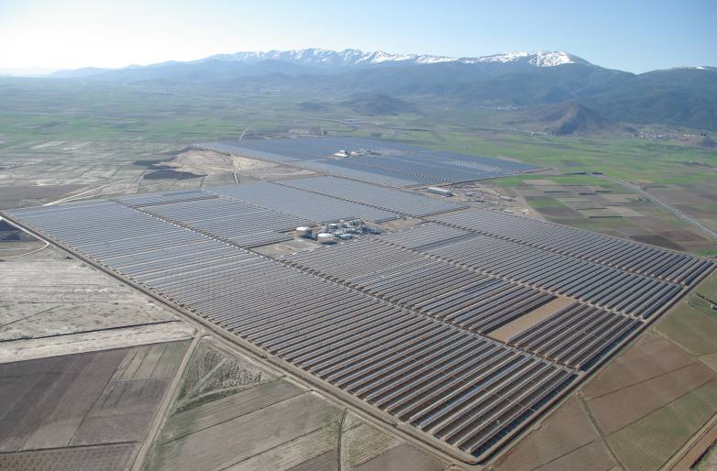
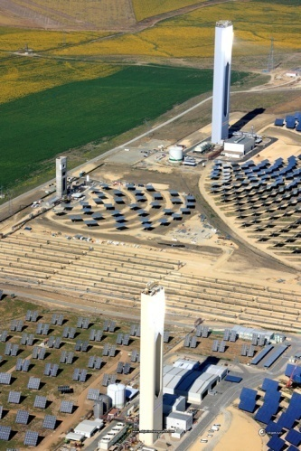
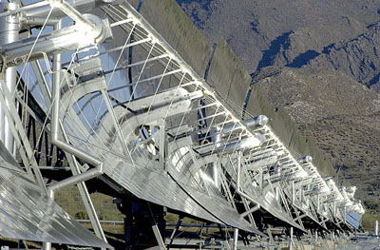
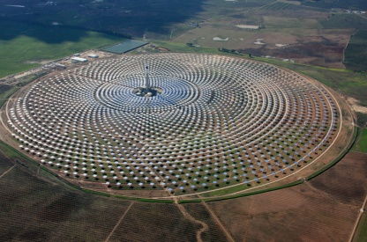
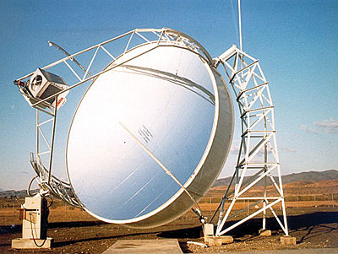
Which technology will succeed?
Tower:
Air (Atmospheric,
pressurized), water, molten salt,
Brayton or Rankine Cycle, hydrogen product.
Large or small heliostats, Multi –single tower
Linear concentration:
Oil, molten salt, water, CO2
Cylinder, Fresnel, others
Steam or Organic Rankine Cycle.
Parabolic dishes
Stirling engine
Heating a Fluid
Thermal storage
Hybrid with coal, gas, biomass.
Water/Dry cooling
Fuels production
ACS, ANDASOL
Abengoa PS solar towers
PSA DSG
Gemasolar solar tower
PSA Stirling

Slide 5
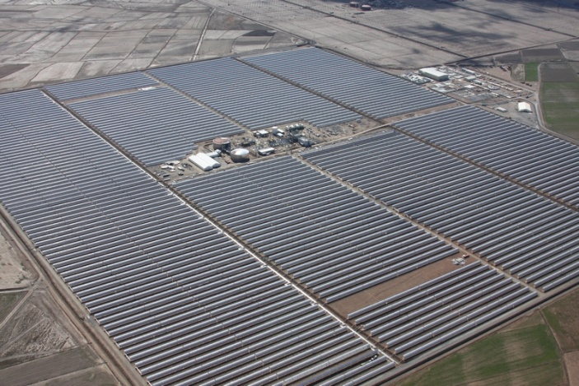

Slide 6
Some figures
50 MW CSP parabolic trough:
500.000 m² mirrors,
90.000 m HCE,
20.000 T of steel
2 GW CSP parabolic trough
20.000.000 m² mirrors,
3.600.000 m HCE
800.000 T of steel

Slide 7
Asia-World
Bright minds together
Find and bring technology to the market together
Reduce time to the market
Reduce development costs
Reduce production cost
Increase volume

Slide 8
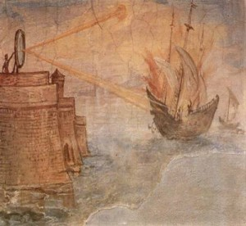
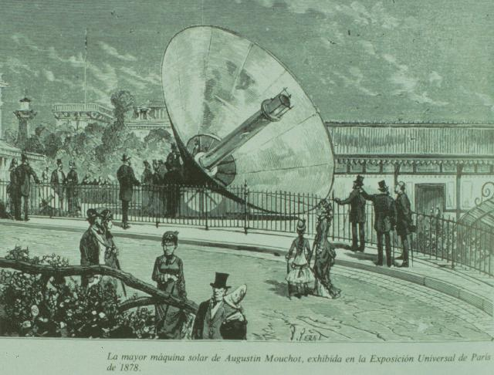
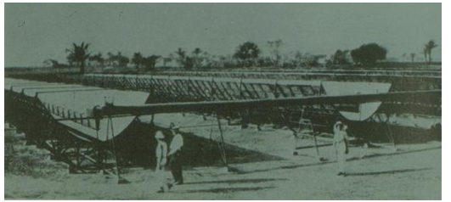
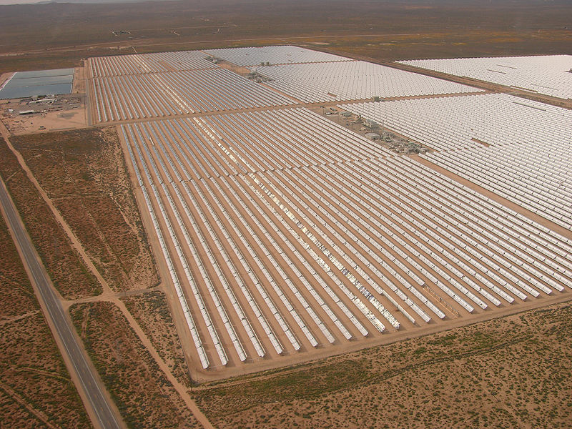
Solar winter or Solar summer
Learning from the past 29 c€/KWh, 45 c€/kWh
Innovative and new ideas
Win-Win global strategies
A new era and industry:
Water
Energy
Clean environment

Slide 9
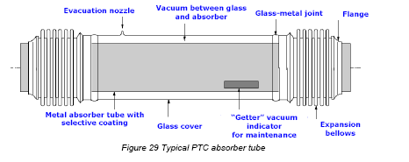
An example Huiyin uses antirreflecting coating from CIEMAT
Improve transmisivity
Durability
Direct impact
HCE, vacuum tube

Slide 10
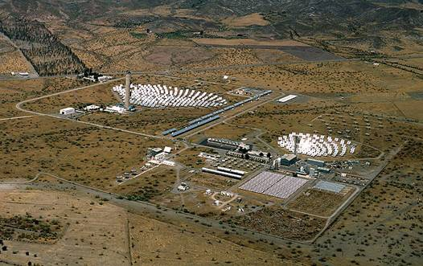
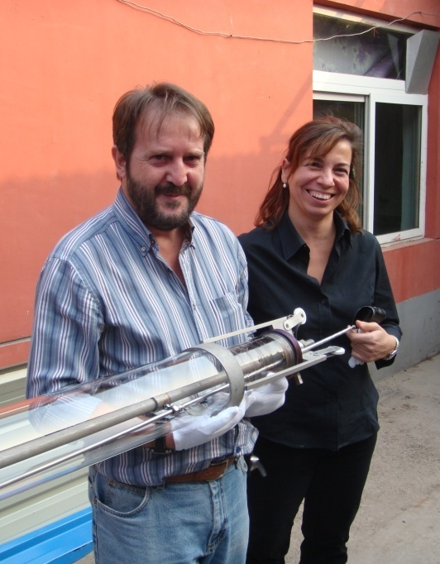
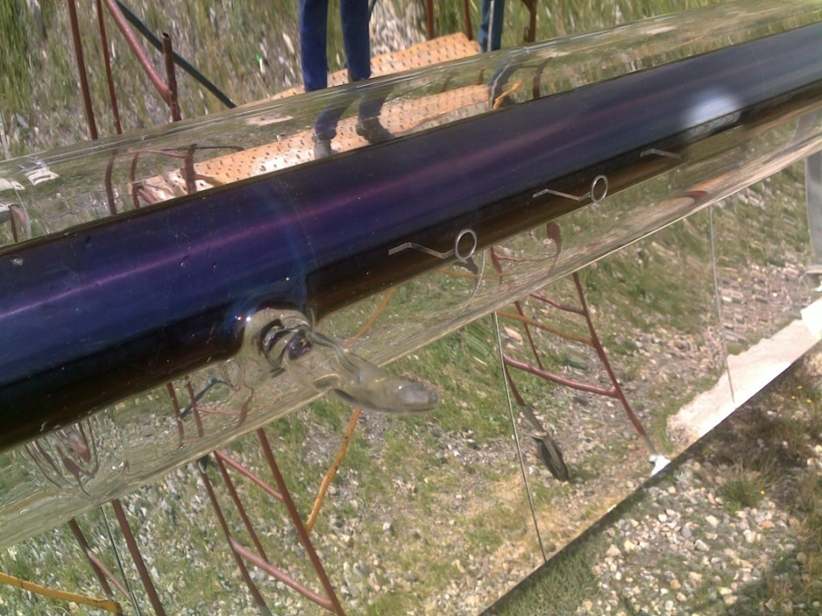
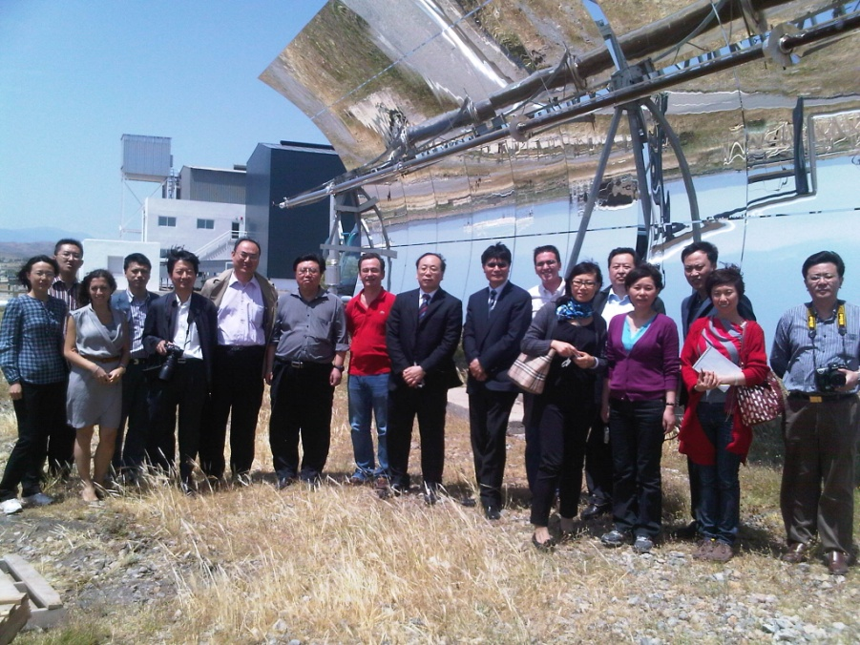
An example Huiyin uses antirreflecting coating from CIEMAT
CIEMAT (Spain) has licensed a coating to Huiyin (China) for its high temperature vacuum tubes now being tested at PSA.
PSA
Huiyin Factory
Vacumm tube PSA

Slide 11
Key factors
Tested product
Multi-skilled, Multi-cultural
Listening and Translation
Long term focus
Mature partners with common goal
Commitment

Slide 12
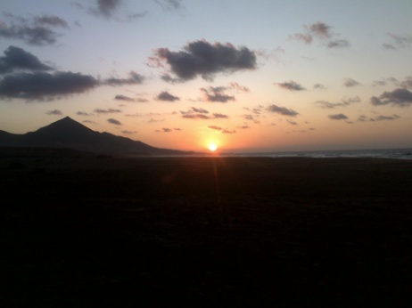
THANK YOU
Cofete Beach, Fuerteventura, Canary Island, Spain

